Slide 1




Data Science HACKATHON
Abubakar Passum A. Gaffar
Faith Mutua
Stancy J.K Bright
[Modeling air humidity for Farming using machine learning]
[THE GREENS]

Slide 2





[THE GREENS]
Problem Statement
Climate change is likely to contribute substantially to food insecurity in the future, by increasing food prices, and reducing food production
Crops
Climate
Change
Exposure to high humidity levels may lead to loss of crop quality due to occurrence and severity of fungal diseases, calcium and water deficiencies.
Economic
Market
The impact of high and low crop production on market consumption
impact

Slide 3


[THE GREENS]
Data Findings
Source
Parameters
Sunyani
Data
Eoric is a research arm of UENR, responsible for providing real time satellite-based data
Weather data recorded from 2017 to 2019. Temperature,RH,WS,WD,Water vapor,
dew, pressure, solar.
Description
Correlation
Trending
Impact
Data
Insight

Slide 4
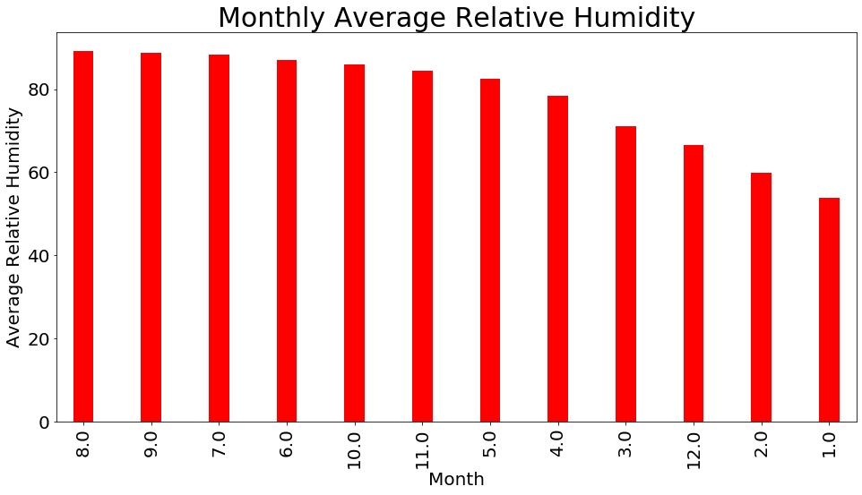
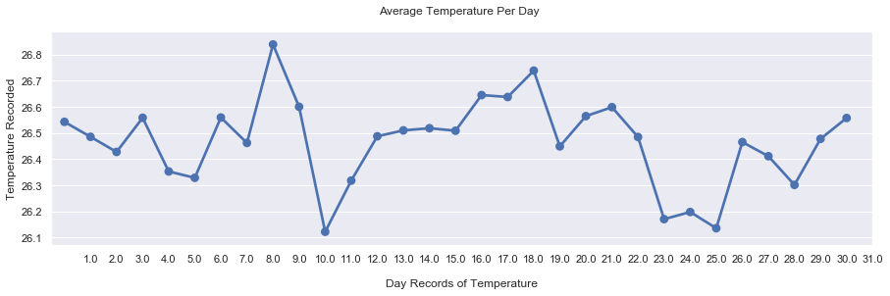
[THE GREENS]
Data Findings
The highest average RH was recorded in August and September with the lowest in January

Slide 5
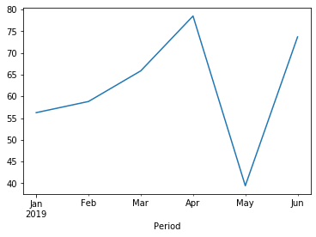
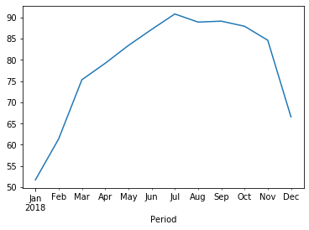
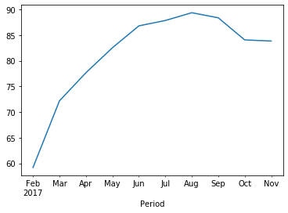
[THE GREENS]
Data Findings
Detecting changes in weather pattern from 2017 to 2019.
Lineplot of Resample Average RH in each Year.

Slide 6
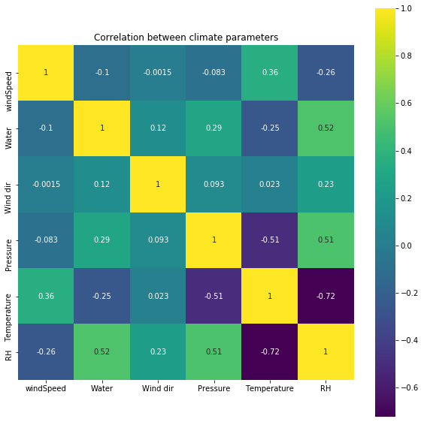
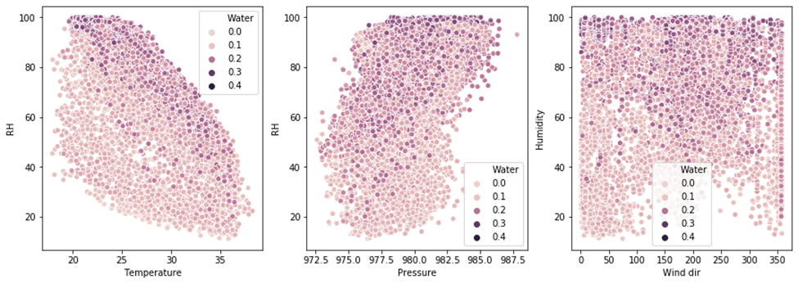
[THE GREENS]
Data Findings
Heatmap to show the correlation between various parameters and the label (RH)
Temperature is highly correlated to RH

Slide 7
[THE GREENS]
Implications
1
High Humidity
Low Humidity
2
Affect Crop quality
Plant water stress
Fungal Disease
Closure of Stomata
Pollination
Quality of crops
Photosynthesis
Photosynthesis
Calcium deficiency

Slide 8









[THE GREENS]
Deep Dive on Solution
ML WORKFLOW
Prepare Data
Train Model
Validate Model
Deploy Model
Monitor Model
Regression
Time series forecasting
Openweather api

Slide 9
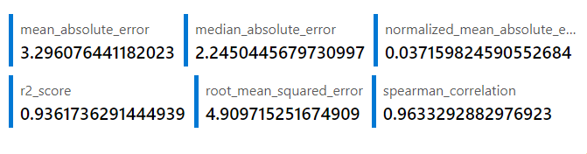
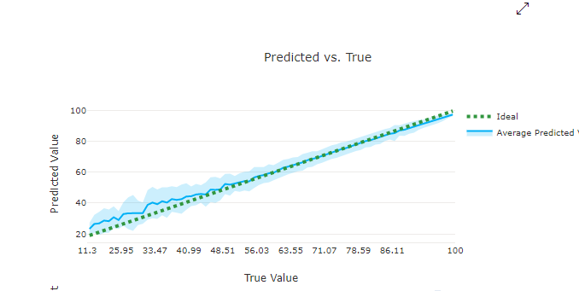
[THE GREENS]
Deep Dive on Solution

Slide 10

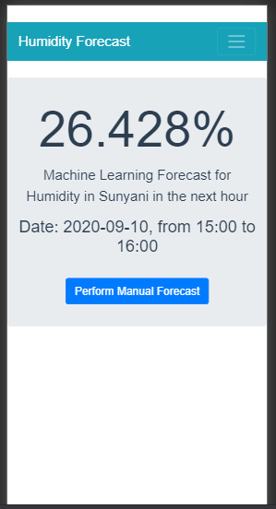

[THE GREENS]
Deep Dive on Solution
Demonstration of the prototype
Web App
Mobile App

Slide 11
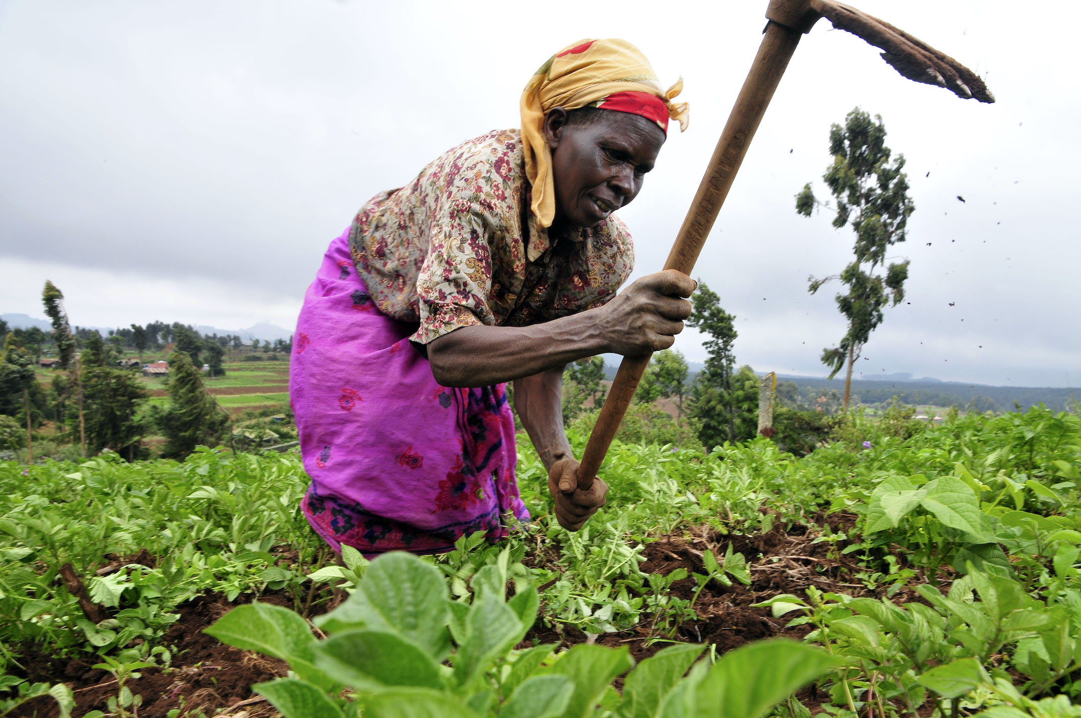
[THE GREENS]
Summary
How it works
Pre-inform farmers about RH to make adjustments
Educate farmers on how to manage RH
Enable farmers to understand weather patterns
It can also be used in greenhouse to model microclimate parameters (RH).

Slide 12

[THE GREENS]
THANK YOU

